Slide 1

A warm welcome to today's workshop!
A strong TEAM
through individual boundaries

Slide 2

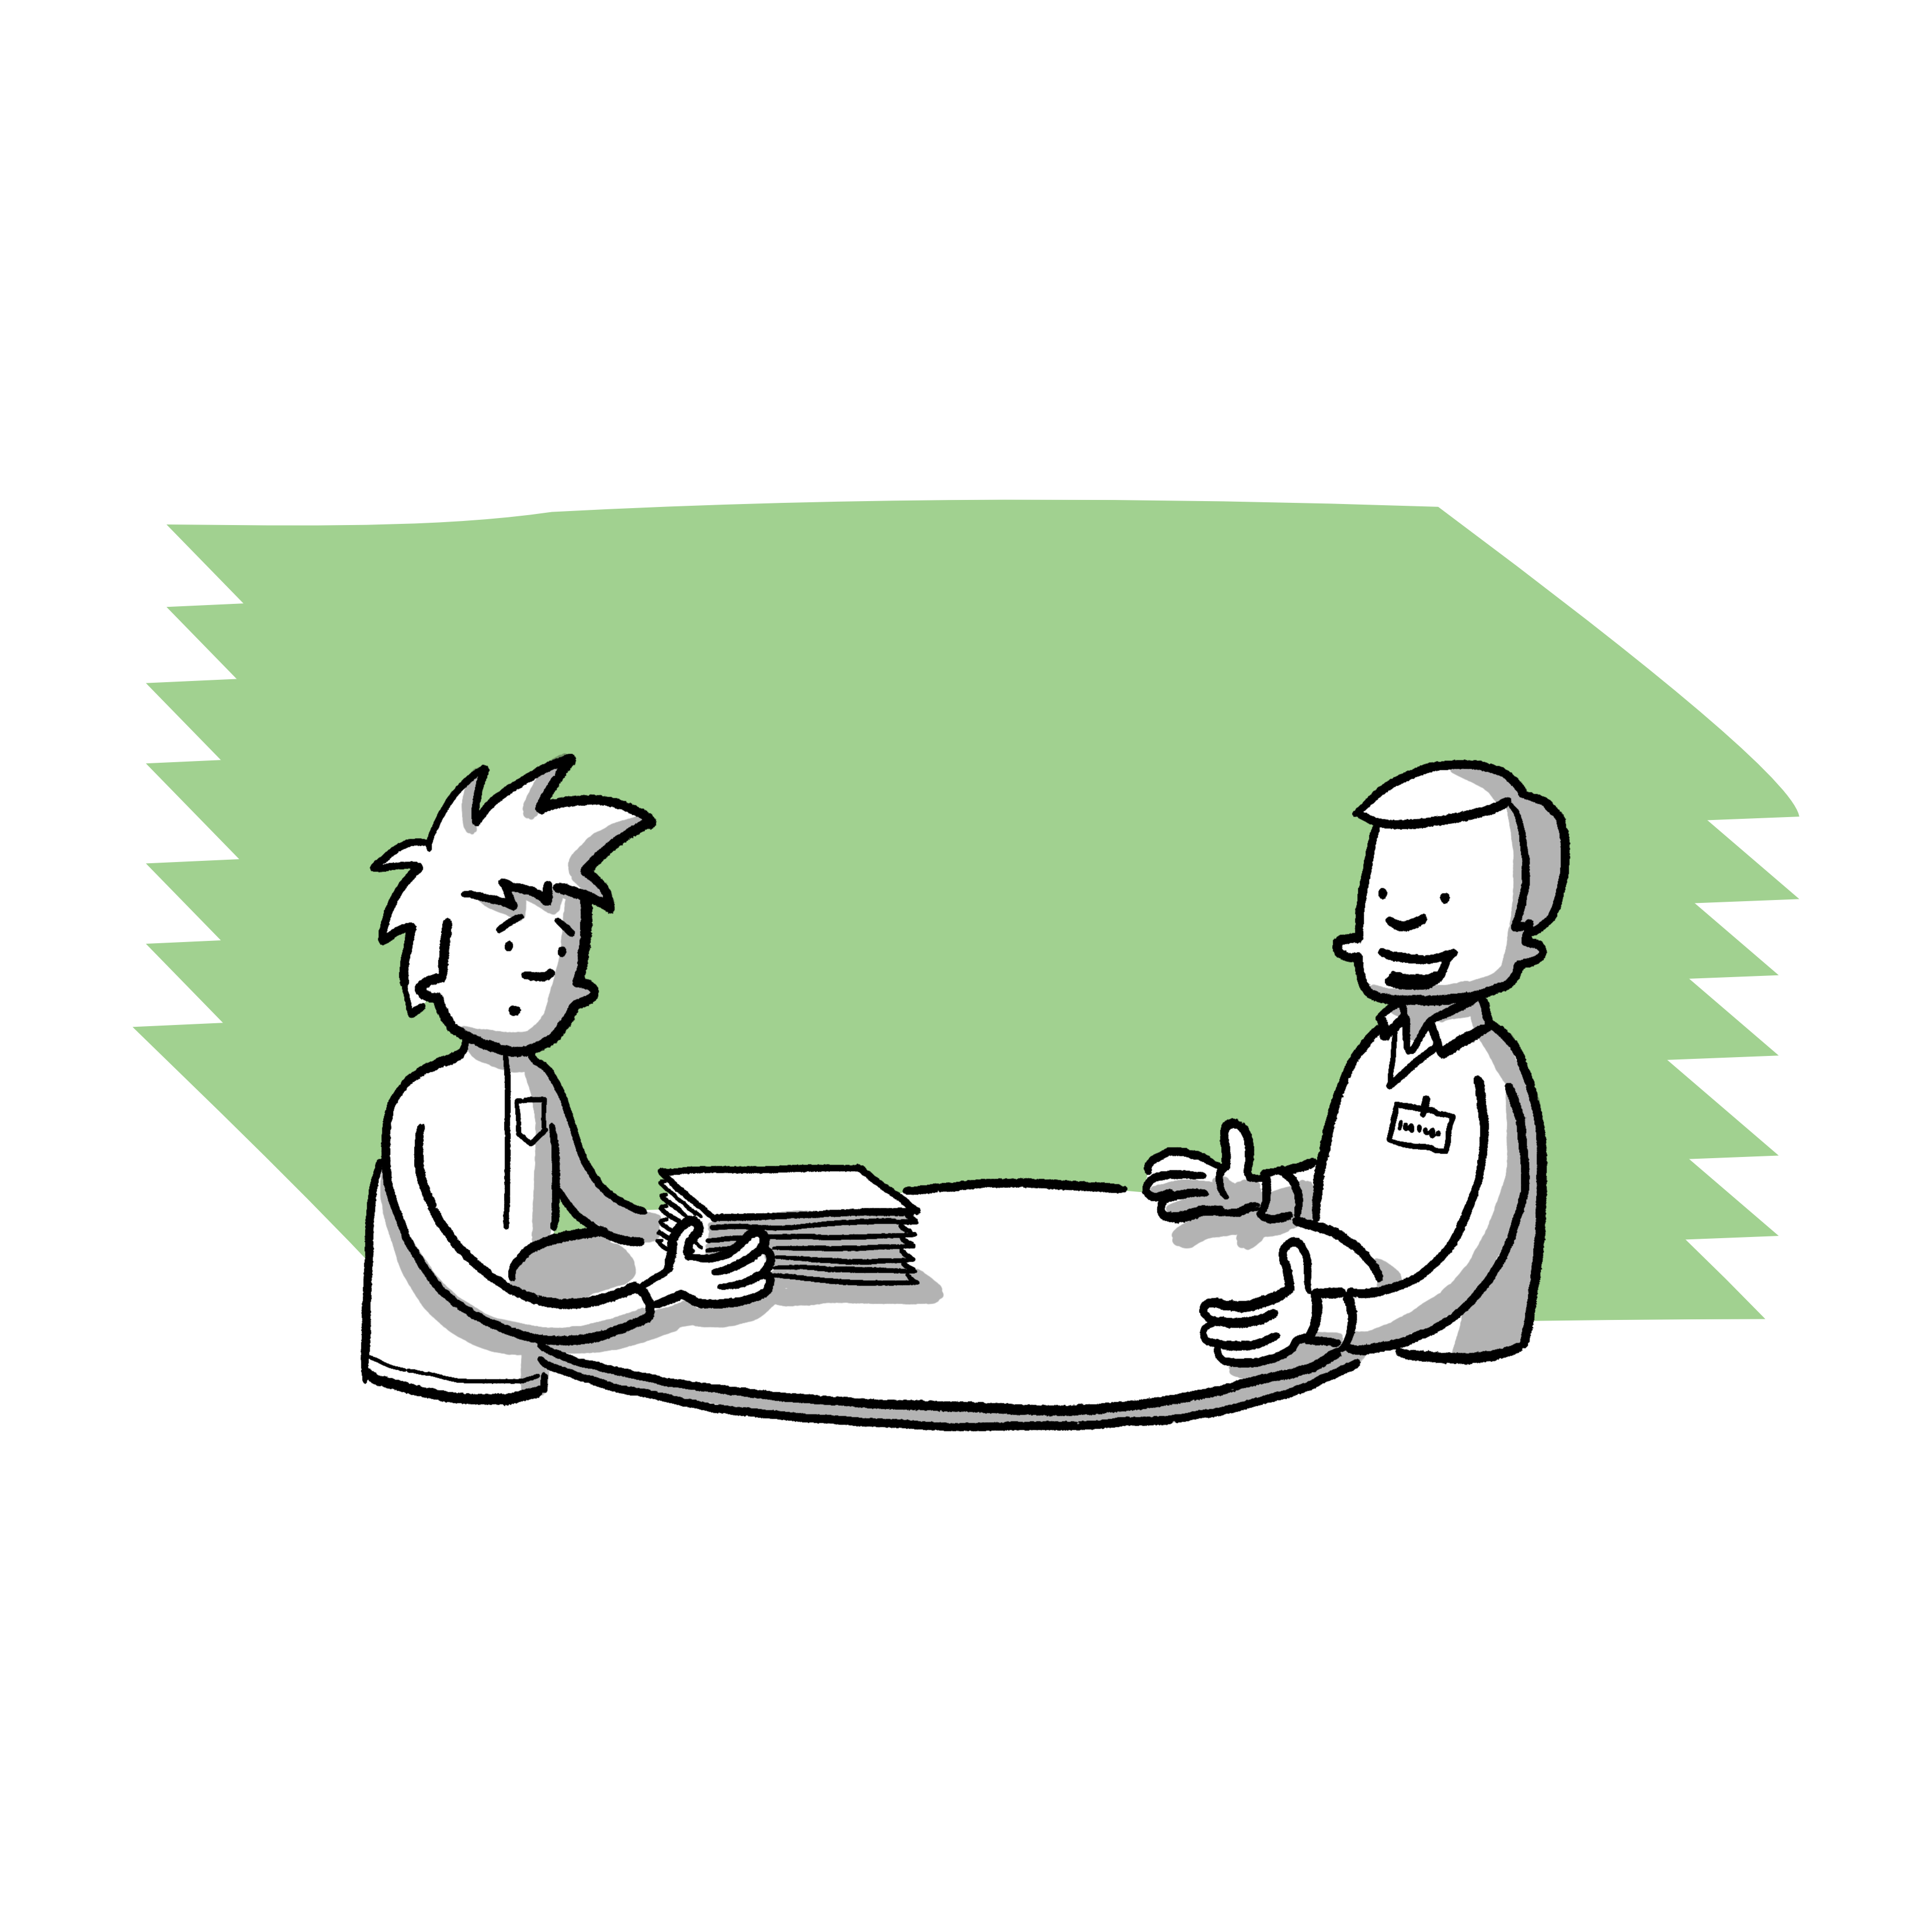
Look, act, help
During the situation
Remain present
Stay in the room
Offer support afterwards
Distract
Get creative and focus attention on something else
e.g. by asking the person concerned something
During or after the situation
Addressing the person affected
Ask about the observed event
Offer support
Involve adults/contact persons
Adult person in the club
Contact person of the club, association
Other reporting centres/assistance systems

Slide 3
Who can I contact?
Contact persons in the club
Name local contact points/cooperation partners
Name contact points of the association/state sports association or similar

